Slide 1
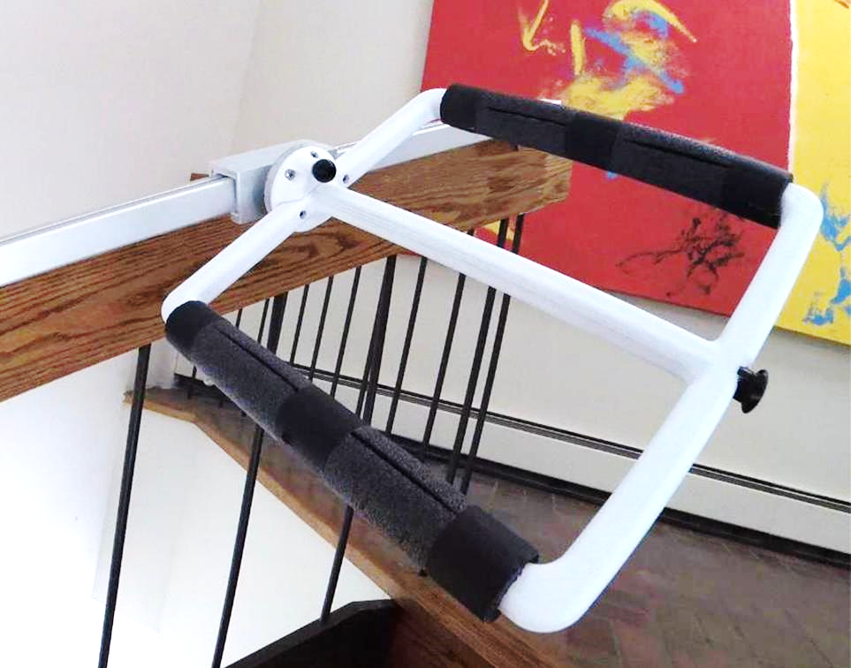
Easy Stairz is an inexpensive solution
for Vulnerable People who need to be able to navigate UP and DOWN stairs in their home
This sophisticated and highly helpful
mechanism simply rests upon your handrail, gliding from stair to stair while offering you great support.
Easy Stairz offers a reliable and cost-effective mechanism that allows a Vulnerable person the ability to descend safely from an Elevator Building during a fire.
Easy Stairz folds flat against the wall when not in use.
Easy Stairz
Click for video

Slide 2
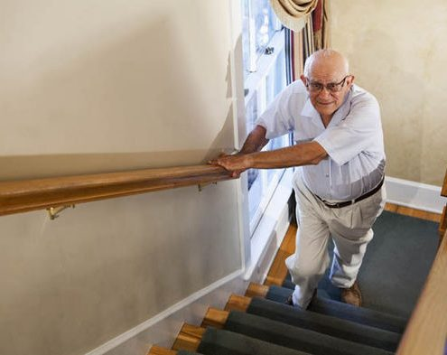
For Sam, this is a SCARY and Dangerous trip upstairs. There’s no safety net to catch him if he tires or his grip weakens.
Going Downstairs is even more difficult and dangerous. Thoughts of Sam’s grip giving way, failing; tumbling headfirst down a flight of stairs…
What if I fall?
If I go downstairs to the kitchen, will I be able to return all the way upstairs to my bed?
I better stay downstairs because I can’t ever answer the door in time from upstairs
If there’s a fire, and I’m alone, how will I be able to get downstairs? I’d better start sleeping in the living room.
Climbing up and down stairs is simply too tiring for me without some assistance.
http://www.easystairz.com

Slide 3
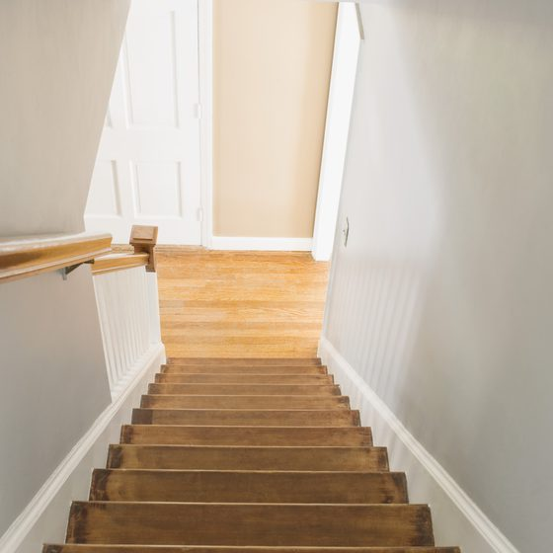
For a Senior Citizen or other vulnerable person, this flight of stairs is a THREAT!
How do I get out of my house if there’s a Fire or Medical Emergency?
I need to be able to move quickly and safely down the stairs. But I don’t have the strength or balance or endurance to manage stairs by myself.
Do I need to sell my house, move downstairs to the living room, move in with my kids, move to an apartment house?
Well, I can’t move quickly and safely when there’s not a fire AND I can’t afford an electric chair rider.

Slide 4
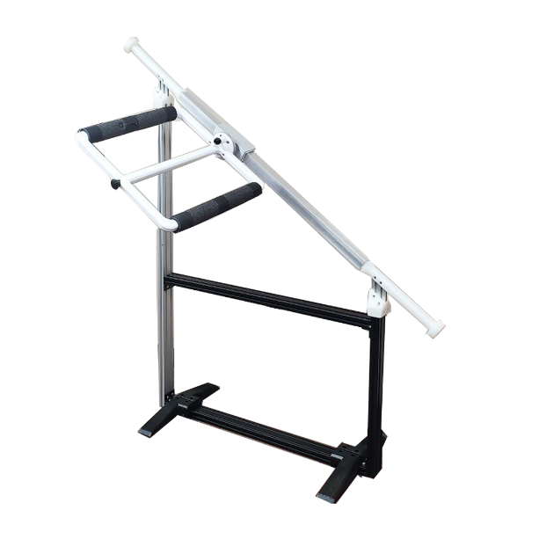

Slide 5
Easy Stairz is a patented device that allows Vulnerable populations (seniors and others that struggle to ascend and descend flights of stairs easily and safely) the security of being able to navigate stairs when elevators are not available.
Owned, Manufactured and Distributed by Living Well Innovations
Visit us @ http://www.easystairz.com
Contact:
Richard Danziger
631-273-3330 x 202
richard@lwiassoc.com

